Slide 1


Workshop Practice-Electrical & Electronics [MME 1061]
Electronic Circuit Components familiarization and Electronic Circuit Assembly

Slide 2
Conducting labs on rotation

Slide 3
ELECTRONIC CIRCUIT ASSEMBLY
Objectives:
1. To familiarize with the discrete electronic components and solderless breadboard.
2. To familiarize with the Digital Multimeter.
3. To test the electronic components.
4. To familiarize with the tools used for soldering.
5. To build a simple +5V DC power supply circuit.

Slide 4
Components -Familiarization:
Resistors,
Potentiometers,
Light Dependent Resistor (LDR),
Rectifier diodes, Zener diodes, LED,
Transistors,
Capacitors,
Integrated Circuits (ICs),
Solderless breadboard,
General purpose PCB

Slide 5
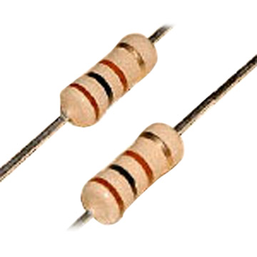
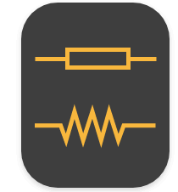
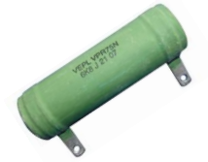
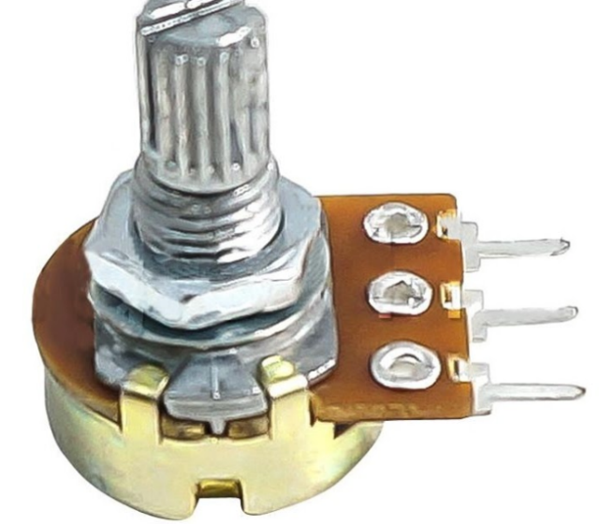
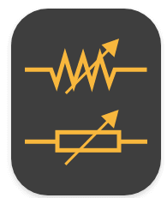
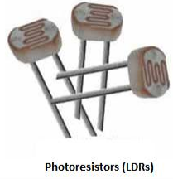
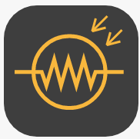
Resistors
Types:
Carbon resistor
Wire wound resistor
variable resistor

Slide 6
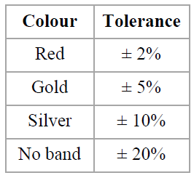
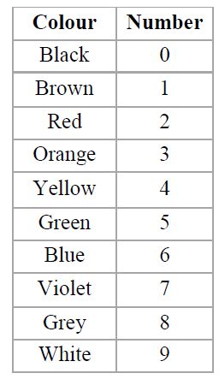
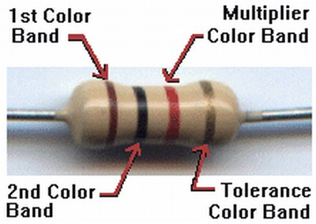
Colour code

Slide 7
Resistor……
Colourcode:
Black,Brown,Red,Orange,Yellow,Green,Blue,Violet,Gray,White
Silver,Gold,No band indicates 10%,5% and 20% tolerance in magnitude respectively.
Wattage: 1/4W,1/2W,1W,2W,5W,10W….
Special case: Multiplier of Gold -0.1
Multiplier of silver -0.01

Slide 8
For a carbon resistor, the bands are Brown, Black, Black and Golden. The nominal value of this resistor is: 10×10 ⁰ Ω = 10 Ω with a ± 5% tolerance.
Thus, the actual resistance may be somewhere between 10±0.5 Ω.
That is, between 9.5 Ω and 10.5 Ω.

Slide 9
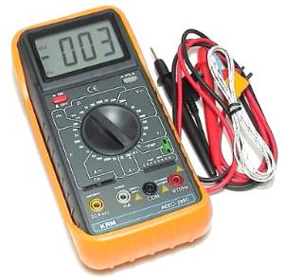
Multimeters(DMM)
Ammeter(dc&ac)
Voltmeter(dc&ac)
Ohmmeter(R &C)
Diode & Transistor check
Continuity Check
Notes:
A multimeter is indeed a multiple meter. It can measure DC and AC voltages, currents, and in addition, resistances. A
digital multimeter (DMM) indicates the measured parameter on a numeric display. Recent DMMs can additionally measure
frequency, capacitance, etc. Two long probes are used to connect the DMM to a circuit
during a measurement. The meter has sockets for probes: • Positive, marked ‘+’, and usually ‘red’, and
• Common (negative), marked COM or '─' and usually ‘black’. The central dial has a knob to choose the parameter to be
measured.

Slide 10
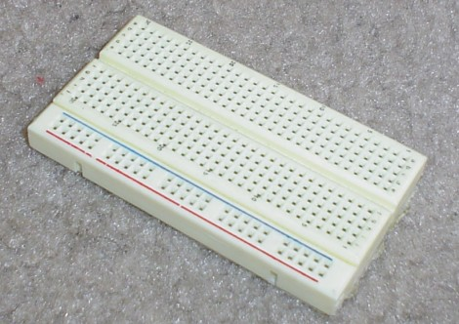
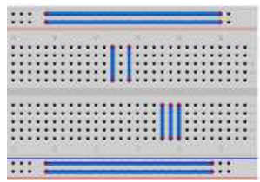
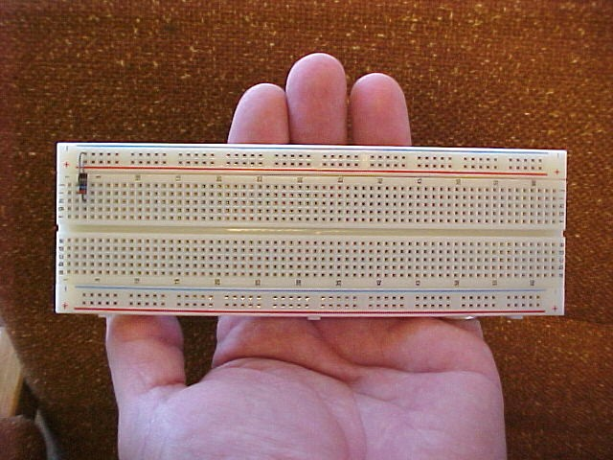
Bread board
How to connect?
Notes:
Breadboard:
A breadboard makes it easy and quick to build
circuits. It is a plastic block with rows of sockets. The
sockets in each row are connected electrically, as
indicated in the figure.
If you plug two or more component wires into the
same row, current can flow from one to the other.

Slide 11
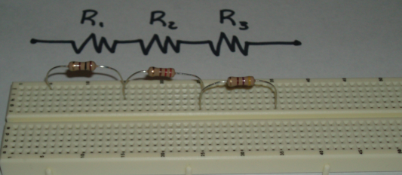
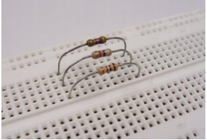
Resistor in series
Resistor in parallel

Slide 12
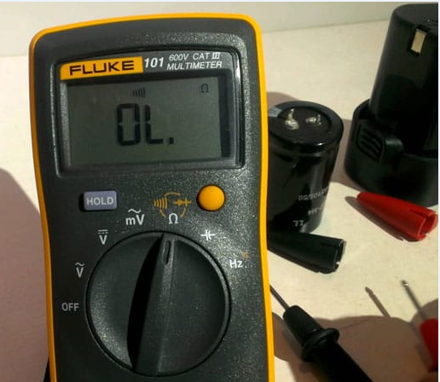
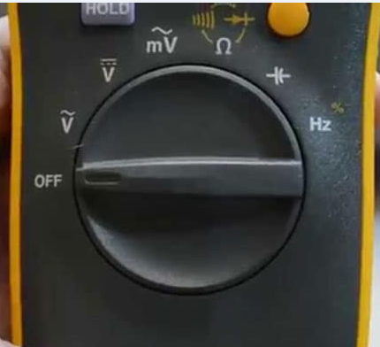

Slide 13
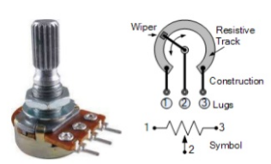
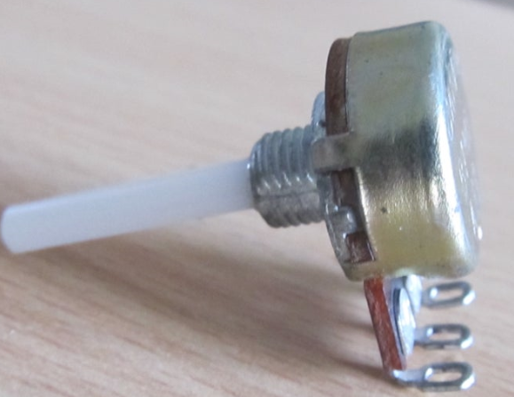
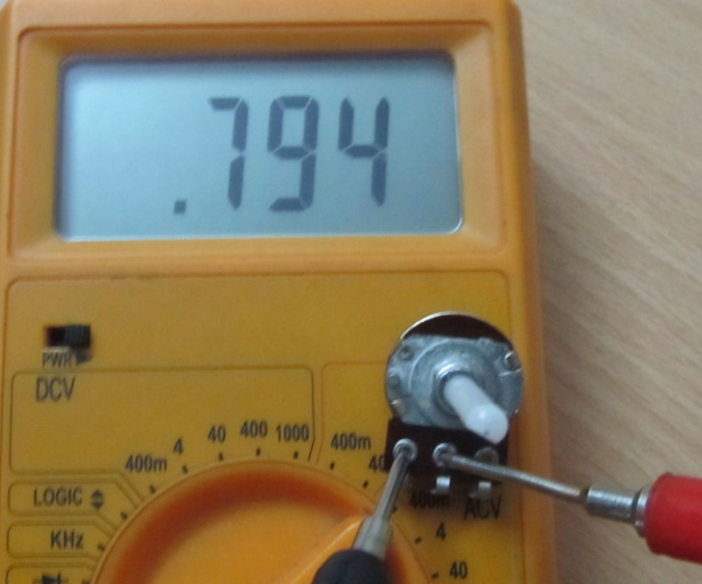
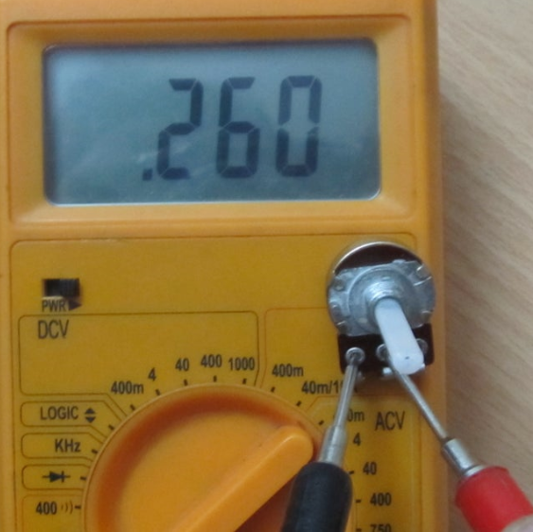
Potentiometer
Notes:
Volume control, brightness control

Slide 14
Capacitors
types
ceramic capacitor
Poly propylene capacitor
electrolytic capacitor
Notes:
Capacitors store electric charge. The ability to do this is called its capacitance. It is expressed in farad. Most electronic circuits need much smaller capacitances. Typical units
are: pico farad, nano farad, and micro farad. There are many types of capacitor. Those used most often are Ceramic Disc, Polyester, Polystyrene, Electrolytic and Variable capacitors.

Slide 15
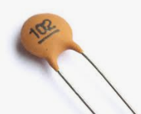
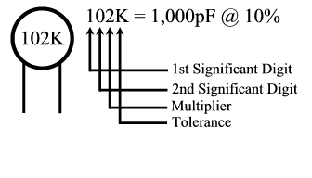
Ceramic capacitors
Smaller rating capacitors
Non polarized
Notes:
Ceramic Disc Capacitor: Ceramic disc capacitors are printed with a code that indicates the value of capacitance. If the code has a 3 digit number printed on it, the first two digits give us the first part of the value and the third digit indicates the multiplier (a power of 10). The resulting value is expressed in pico farad (pF).

Slide 16
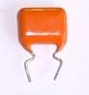
Poly propylene capacitor
Higher voltage rating
Non polarized

Slide 17
Capacitor-1 has the code of 472. So, its value is 47×10² pF = 4.7 kpF or 4.7 nF
Capacitor-2 has the code of 101. So, its value is 10×101 pF = 100pF

Slide 18
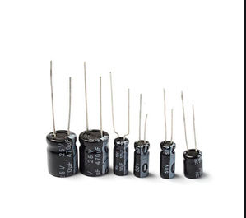
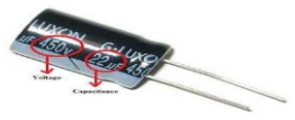
Electrolytic capacitors
Higher rating Capacitors
Used in Filter Circuits
Polarized
Notes:
Electrolytic capacitors: These are used to store large amounts of charge. Their capacity is usually 1 μF or more. Electrolytic capacitors are polarized. This means that they have positive and negative terminals. They must be connected the right way round. A reversed polarity can cause an explosion!
• These can store charge for hours. When building or testing circuits, there is a danger from electric shock if you touch its terminals without giving it, time to discharge fully

Slide 19
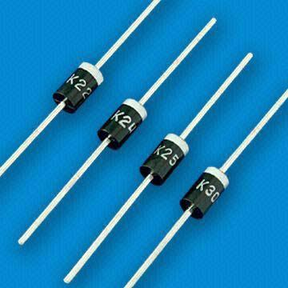
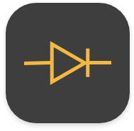
Diodes
Notes:
A diode is made of semiconductor. It is contained in a small capsule made of glass or plastic. It has two terminals, namely, anode and cathode. A band marked on the diode indicates the cathode terminal (symbol ‘K’). A forward biased diode (with its anode held positive relative to its cathode) conducts. However, it
blocks the applied voltage when reverse biased (i.e., cathode held positive relative to anode). This property is used in rectifiers for AC to DC conversion.

Slide 20
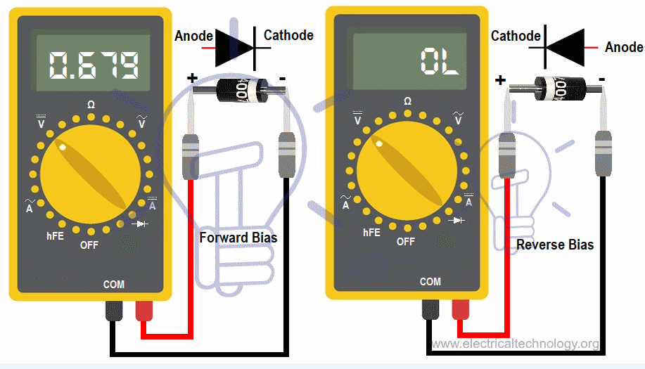

Slide 21
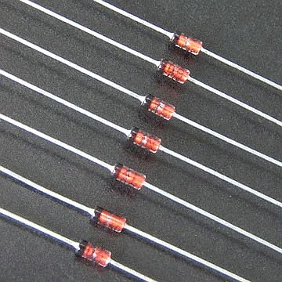
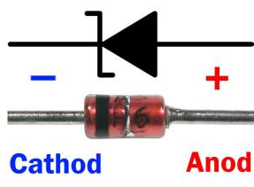
Zener diode

Slide 22
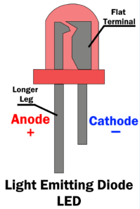

Slide 23
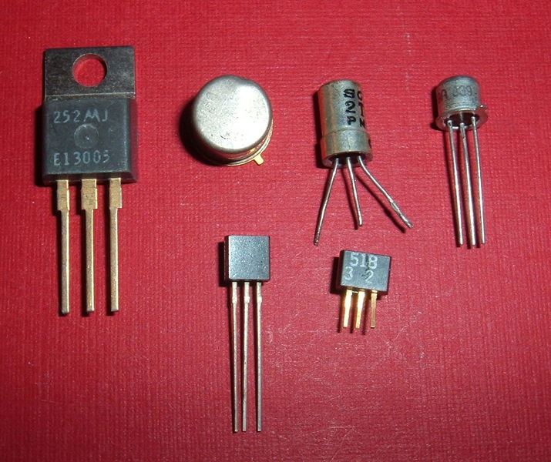
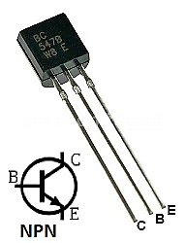
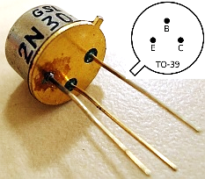
Transistors

Slide 24
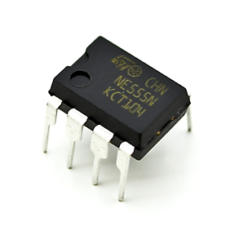
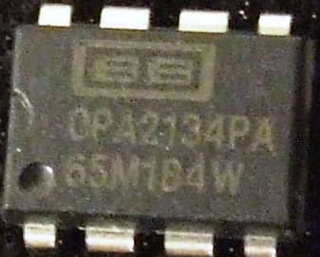
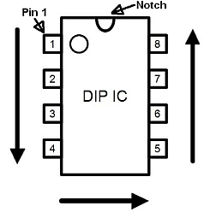
Integrated Circuits OPAMP,555 timer

Slide 25
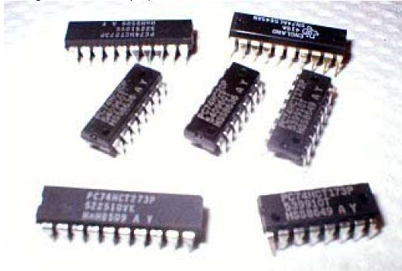
Digital IC
Identify the notch on IC
Place the IC on socket and lock it properly

Slide 26
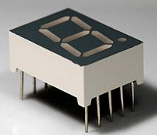
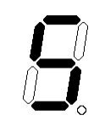
Seven segment display
Notes:
Photo resistor is a type of resistor whose resistance varies with change in light intensity; more light leads to less resistance and less light leads to more resistance. These inexpensive sensors can be easily implemented in most light dependant robots.

Slide 27
Objectives:
4. To familiarize with the tools used for soldering.
5. To build a simple +5V DC power supply circuit.
Components Required:
230V/9V, 100mA transformer, 1N4007 diodes, Carbon resistor 470Ω, LED, Capacitor: 100μF/25V Electrolytic, 7805 Voltage Regulator IC, DMM, PCB, Soldering equipment, small nuts and bolts.

Slide 28
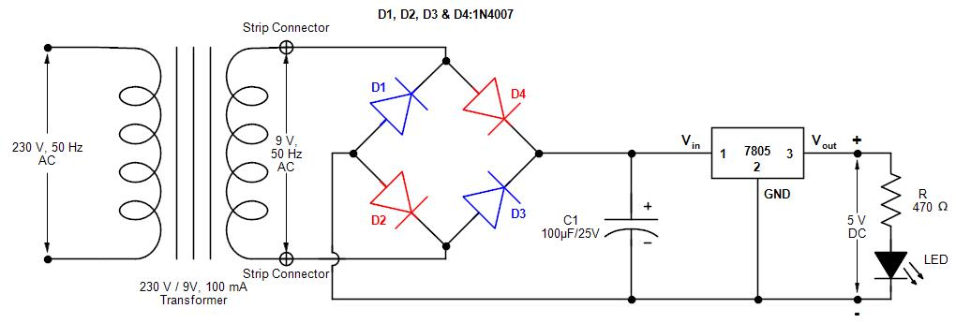
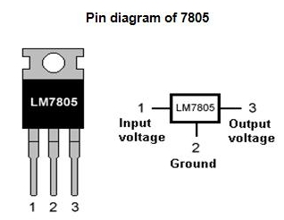
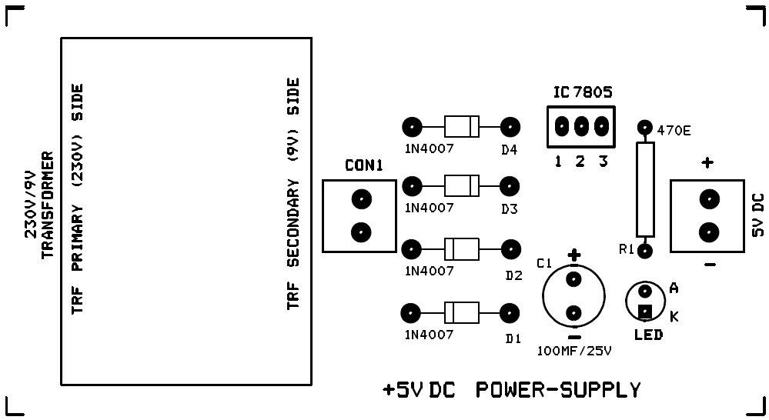
Notes:
A printed circuit board, or PCB, is used to mechanically support and electrically connect electronic components using conductive pathways, tracks or signal traces etched from copper sheets laminated onto a non-conductive substrate. It is also referred to as printed wiring board (PWB) or etched wiring board.A PCB populated with electronic connectors and components is called a printed circuit assembly (PCA), printed circuit board assembly or PCB Assembly (PCBA). Multisim / Eagle

Slide 29
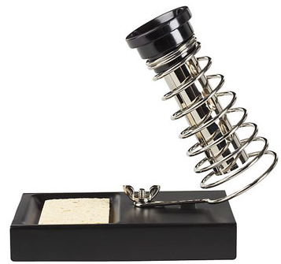
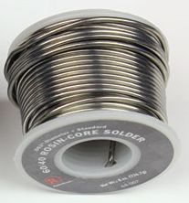
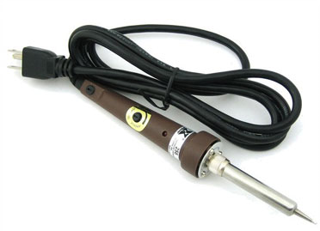
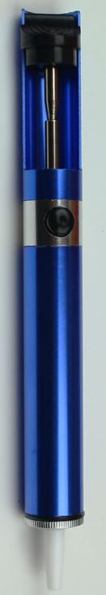
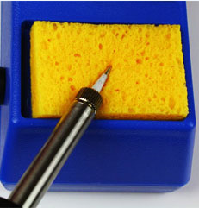


Soldering Tools

Slide 30




Soldering and Desoldering

Slide 31
Precautions: General:
1. Check all the components as per parts’ list and confirm that no part is missing.
2. Test the components individually.
3. Identify anode and cathode of rectifier diodes and LED; before soldering.
4. Pay attention to the polarity of the electrolytic capacitor.
5. Identify the legs of the voltage regulator IC.
6. Ensure that the power switch is in OFF position before plugging in the power cord on the transformer primary side (230V AC side).
7. If you find any faulty condition, it is not wise to leave the power on for a long time. The components may burn out.

Slide 32
Testing the circuit:
1. Plug in the power cord on the primary side of the transformer to the AC power
socket on the experimental table.
2. Switch on the AC supply to the circuit.
3. Observe the LED glow continuously.
4. Measure the output DC voltage of the circuit using the DMM.
5. Press ‘DC/AC’ button on the DMM to set it to measure AC voltage. Measure the
input AC voltage to the diode bridge at connector-1 [CON1].
6. Switch OFF the AC supply.

Slide 33
Observations:
Input RMS AC Voltage to the diode bridge (V) | Input DC voltage to the 7805 IC (V) | Output DC Voltage (V)

Slide 34
Thank You

